Slide 1
Journée des Communautés 2015
Xamarin pour vos développement d'applications cross-plateforme

Slide 2
Speakers
Valentin Michalak
Alternant chez Soat – MSP
Réacteur Windows Generation
@Humanbomb
Antony Canut
Alternant chez Soat – MSP
http://antonycanut.net
@AntonyCanut
Alex Danvy
Microsoft
http://danvy.tv
@danvy #xplat #iot
Nicolas Besson
Windows Embedded Lead
Adeneo Embedded
@Nicolas_Besson
Fabien Decret
Responsable activité mobile
Adeneo Embedded
Windows Embedded MVP

Slide 3
What is the Internet of Things?
Gartner: Internet of Things is the network of physical objects that contain embedded technology to communicate and sense or interact with their internal states or the external environment.
We could add “Human” & “Intelligence”
Interact with
Send and Receive
To the Cloud
Learning & Inisghts
Advice, Recommendations & Instructionrs
For Entirely New Experiences

Slide 4
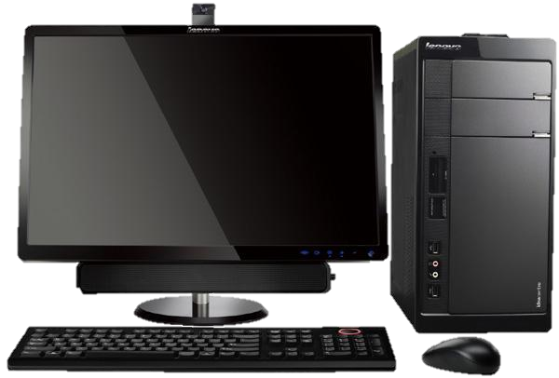
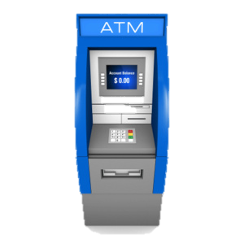
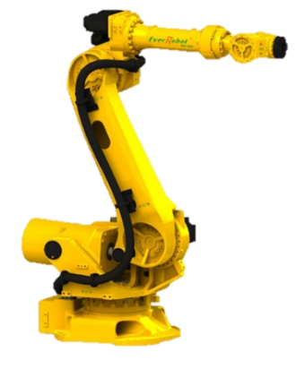
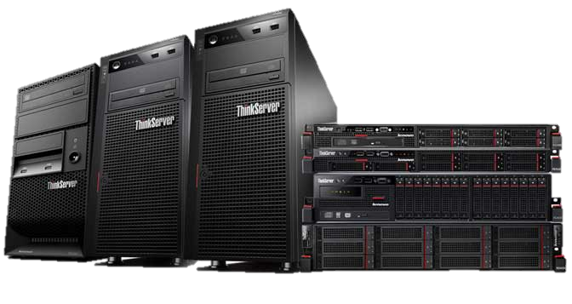
Yesterday
Windows
Administration
Windows Embedded
Windows Server, SQL Server, Office 365
Clients : Dash board, Remote control
Servers : Store data, Configuration, Business logic, Business Intelligence
Objects : Sensors, UX, Communication
-> sensor data
<- commands
<- configuration
System Center
Notes:
This is how things are running for the last two decades and it’s not close to an end.

Slide 5
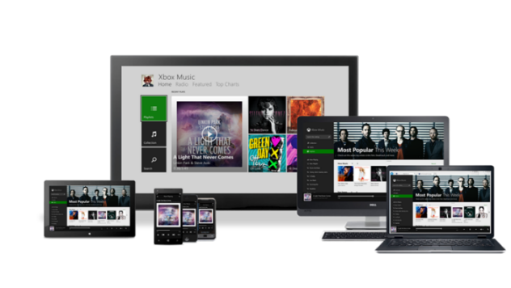
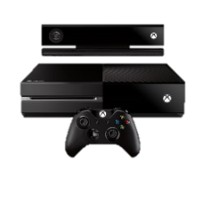

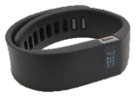


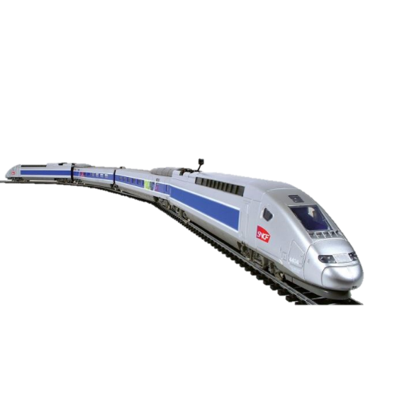
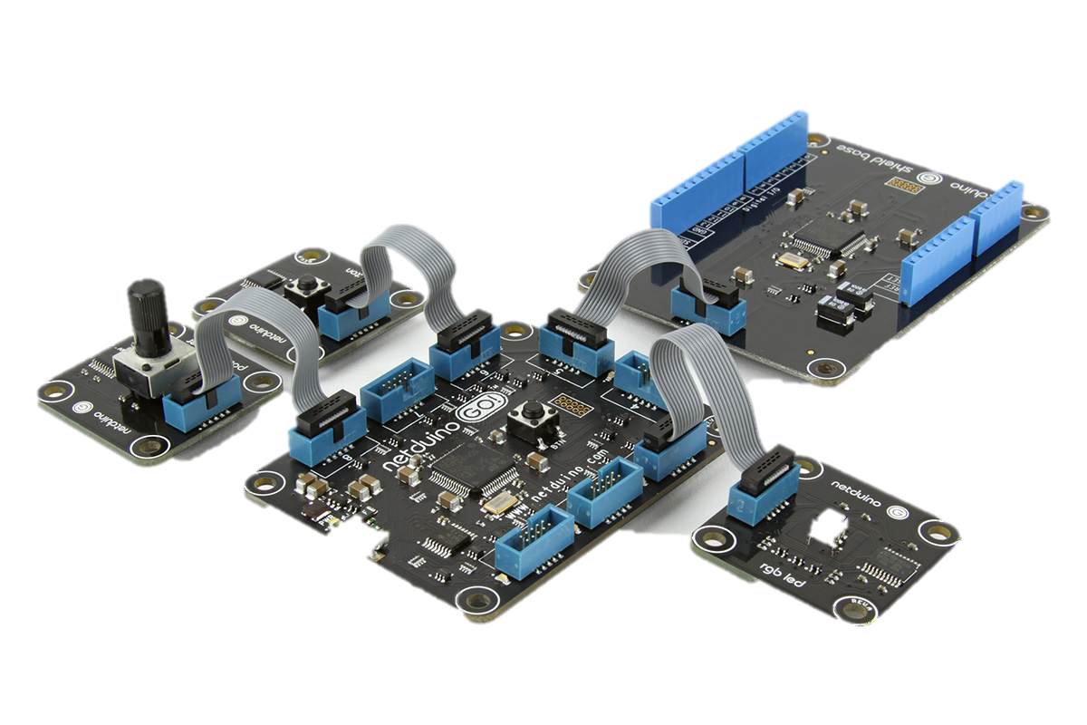
Today
Windows, Windows Phone, XBOX, wearable
Administration
Windows Embedded, Netduino, Quark
Windows Server, SQL Server, Office 365, Azure, HD Insight/Hadoop, ML, ISS
Public Cloud
Clients : Dash board, Remote control, Gateway
Public Cloud :
Store data (BigData), Configuration, Business logic, Business Intelligence, Machine learning
Private Cloud
Objects : Sensors, UX, Communication
-> sensor data
<- commands
<- configuration
Servers : Store data, Configuration, Business logic, Business Intelligence, Privacy
System Center
MS value proposition : secured, integrated on the full value chain, flexible
Notes:
Consumer
Devices + best OS for IoT + apps Windows has been though with information consumption in mind. Modern design focus on content. Live tiles give a overview of your things.
Business
From the prototype to the Cloud
Microsoft is an IoT player for decades now. A lot of ATM, gaz stations, etc. are running on Windows Embedded.
We embraced the modern IoT challenges with Azure, our Cloud solution, simplifying how to store and deal with huge volume of data (Storage, SQL, HDInsight/Hadoop), extract information (BI) and bring intelligence to the story (Machine Learning). Azure has solutions for small set of devices (Azure Mobiles Services) to the most demanding scenarios of thousands devices (EventHub,
Devices and apps create the link to the business

Slide 6
IOT Market Potential A world of big numbers
26
$300B
$1.9T
billion
units
global economic
value add
Incremental revenue
Source: Gartner, Forecast: The Internet of Things, Worldwide, 2013

Slide 7
Every industry can benefit from IOT
Smart Manufacturing
Smart Energy
Smart Mobility
Smart Retail
Smart Health
Smart City
Smart Building
Smart Home
Smart Wearables
Smart ?

Slide 8
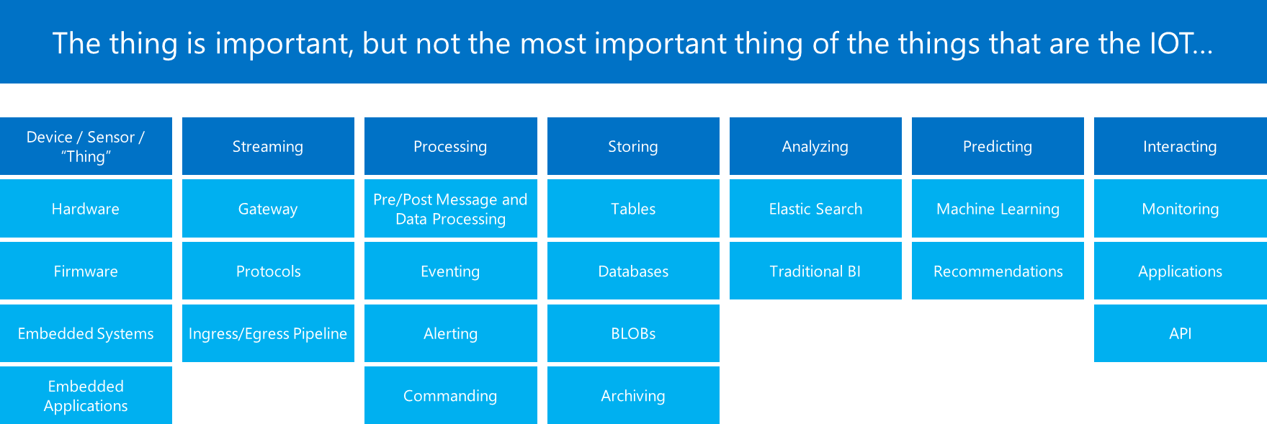
Why is this IOT thing so interesting?
Azure
Services
Azure
Services
Azure
Services
Azure
Services
Azure
Services
Azure
Services

Slide 9
Why Microsoft?
Global scale
Worldwide reach and hyperscale required to bring cloud economic benefits to every business
Comprehensive
Enterprise-grade
Unmatched breadth of capabilities essential for your business transformation
Decades of experience building and running trusted global cloud services
People-centered experiences
Hybrid cloud
Experiences employees want with the control IT needs
Flexible cloud services, scalability, and capacity that fit your business
Notes:
Key goal of slide: land what makes the Microsoft Cloud Platform different, unique.
Talk track:
We understand that there is a lot of competition when you consider all of the productivity, app, and platform players out there.
We looked hard at what makes Microsoft unique in this space and asked customers, partners, analysts, and our people, “what are our points of differentiation? What helps set us apart from the rest?” Hard questions. Soul-searching questions to find the core of what makes is valuable to you.
The big answer that came back was interesting: no other company has the complete and flexible suite of capabilities like Microsoft and the experience to back it up. Some companies have great productivity capabilities but don’t have business apps or platform experience. Some companies have great platform expertise but no productivity or apps.
A recent IDC report says that 67 percent of customers expect to purchase multiple services from a single Cloud vendor. That means that cloud vendors that provide options and multiple services have a decent shot of getting more business. I know you don’t particular care about that – but it further validated our approach. We want to give you options, choice, flexibility, and back it up with rock-solid performance and security. That’s what Microsoft has been all about since the beginning.
Let’s take a moment to look at the five things that make the Microsoft Cloud different, things you should be considering when you’re selecting a cloud vendor.
Global scale: We provide the worldwide reach and hyperscale needed to break the cloud entry barrier giving you better economics, business agility, and availability. This is all of our experience running some of the largest cloud services in the world. You get to benefit from all of that knowledge and our global platform. When you’re ready to scale, we’re ready.
Enterprise-grade: We have proven enterprise experience coupled with security and compliance investments, giving you the confidence that your business demands. We’ve been working very hard for decades to become enterprise-grade, a badge of honor that we hold dear.
Comprehensive: We offer an unmatched breadth of capabilities that provide IT simplification and the consistency essential for your business transformation. We make it easy to connect things through a unified identity and access management system enabling single-sign on to employees.
Hybrid cloud: This is the big one. We believe it’s critical that we provide flexible cloud services, scalability, and capacity that increase the value of existing technology investments to best fit your business needs. We understand that you can’t start over in the cloud overnight. You need flexibility when it comes to managing and making best use of existing on-premises investments, providing a path to the cloud, and for all of your cloud needs.
People-centered experiences: We’re committed to providing the experiences that end users want, with the control IT needs, designed to produce higher productivity and extend skillsets to cloud for innovation with minimal training costs. With Office, Dynamics, and Azure all working together, your people will be productive and delighted by the integrated experiences that just work.

Slide 10
Global scale
Quincy
Chicago
Cheyenne
San Antonio
Boynton
Des Moines
Brazil
Dublin
Amsterdam
Singapore
Hong Kong
Shanghai
Worldwide reach and hyperscale required to bring cloud economic benefits to every business
100+ datacenters in more than 40 countries
Japan
Australia
1M+ servers
Notes:
Key goal of slide: highlight our global scale.
Talk track:
Let’s take a moment to drill into each of the five differentiators. First up is our global scale.
Over the last few years we’ve truly delivered a huge infrastructure to enable us to grow our services at scale around the globe. It is really key for us to make smart investments around the world to deliver services in a resilient and reliable fashion.
Let’s pause for a second to take in the numbers: one million (and growing) servers across over 100 datacenters located in 40 countries.
This network powers our first-party applications—we are committed by service level agreements to ensure great experiences and uptime.
Imagine what it would take for your business to have this level of infrastructure. What if you wanted to expand into a new region of the globe? How much work does that represent in terms of building the technology infrastructure to support? We’ve taken away all of the pain and expense through the datacenter investments we’ve made.
This is the power of the Microsoft Cloud: you get access to world-class global resources to grow your business.
Example: in just a few years Office 365 became the most subscribed cloud service in the world. It scaled from almost nothing to one of the biggest and continues to grow. This is how we can help you.
A lot of people ask, “what goes into site selection at Microsoft and how do we decide where to place our datacenter investments?” There are over 35 factors in our site selection criteria. But really, the top elements are around proximity to customers and energy and fiber infrastructure, ensuring that we have the capacity and the growth platforms to be able to grow our services.

Slide 11












Microsoft Azure IoT services
Producers | Data Transport | Storage | Analytics | Presentation & action
 | Event Hubs (Service Bus) | SQL Database | Machine Learning | Azure Websites
 | Heterogeneous client agents | Table/Blob Storage | HD Insight | Mobile Services
 | External Data Sources | DocumentDB | Stream Analytics | Notification Hubs
 |  | External Data Sources | Cloud Services | Power BI
 |  |  |  | External Services
{ }
Notes:
Key goal of slide:
As we think about Azure services for IoT, there are a collection of capabilities involved.
First there are Producers. These can be basic sensors, small form factor devices, traditional computer systems, or even complex assets made up of a number of data sources.
Next we have the Data Transport capabilities on the ingress level within and around Azure. The primary destination is Service Bus Event Hubs, but this relies on client agent technology either at the edge device level or within a field or cloud gateway. We also have capabilities for other external data sources o provide data (eg: TKA, LU)
As data is ingressed to Azure, there are various Storage options there can be a number of destinations engaged. Traditional database technology, table or blob, or even more complex destinations like Document DB are possible. External or third party technologies can also be used. This is where the flexibility and agility of a platform shows its strength, This is where analysts like Gartner are forming opinions about just how robust our platform can be.
As this data is processed in Azure, there are a number of capabilities that can be utilized. Machine Learning, HD Insight, Stream Analytics are examples of tools that can process the data in various ways.
Finally the concept of data presentation uses Azure services. Data may populate a LOB portal, be pushed to apps, or presented in analytics and productivity tools. These are all ways that the data gets out of these architecture points to allow organizations to use analysis to change / transform their business.
Through all of these areas, there is the possibility of utilizing existing investments either within your Azure environment, or elsewhere.

Slide 12

Platform Convergence Journey
Windows Embedded Standard 7
Windows Embedded Standard 8
Converged
OS kernel
Windows Embedded 8.1
Windows Embedded 8
Converged
app model
Windows 10
Windows Embedded 8.1 Handheld
Windows Embedded 8 Handheld
Windows Embedded Handheld 6.5
Windows on Devices
Porting Tools
Windows Embedded Compact 7
Windows Embedded Compact 2013

Slide 13
Windows 10 for IoT Devices The power of Windows and the Windows ecosystem on my embedded devices gets me to value faster
Windows 10 IoT for Industry Devices
Windows 10 IoT for Mobile Devices
Windows 10 IoT for Small Devices
One Windows core scalable across devices
One universal app and driver platform
One management and deployment approach
Enterprise-grade security
Advanced Customization and lockdown capabilities
Continued innovation and support
Local connectivity
Cloud connectivity
Device services
One Windows Platform
Secure
Connected

Slide 14
Windows 10 IoT Editions
Requires desktop or desktop apps– Win32, .NET, WPF, etc. ?
For Industry Devices
Desktop Shell, Win32 apps
1 GB RAM, 16 GB Storage
Requires a Shell experience, multiple applications, Windows first-party applications, or mobile voice?
For Mobile Devices
Modern Shell
Mobile Chassis requirement
512 MB RAM, 4 GB storage
Windows Device Services
On all Windows IoT clients
Extends value of Windows for OEMs
OS telemetry, update management, interoperability
Azure IoT-ready
Otherwise
For Small Devices
Dedicated devices
No Shell/Store/MS Apps
256MB RAM, 2GB storage
Universal Apps

Slide 15
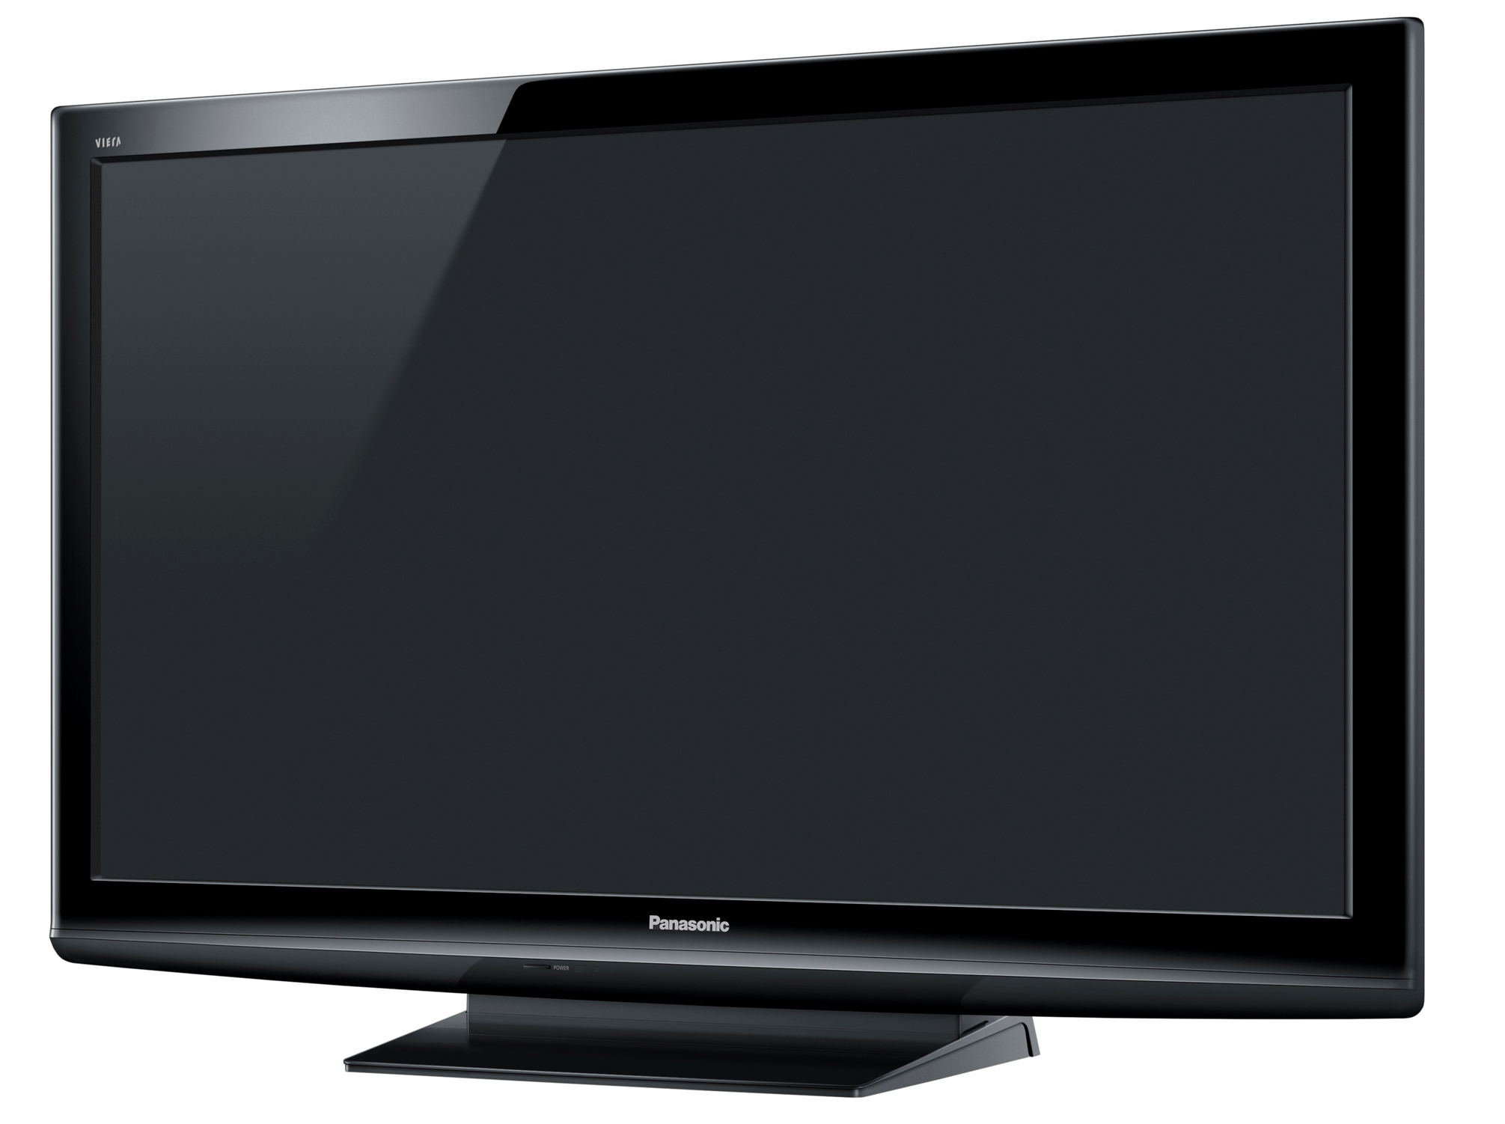
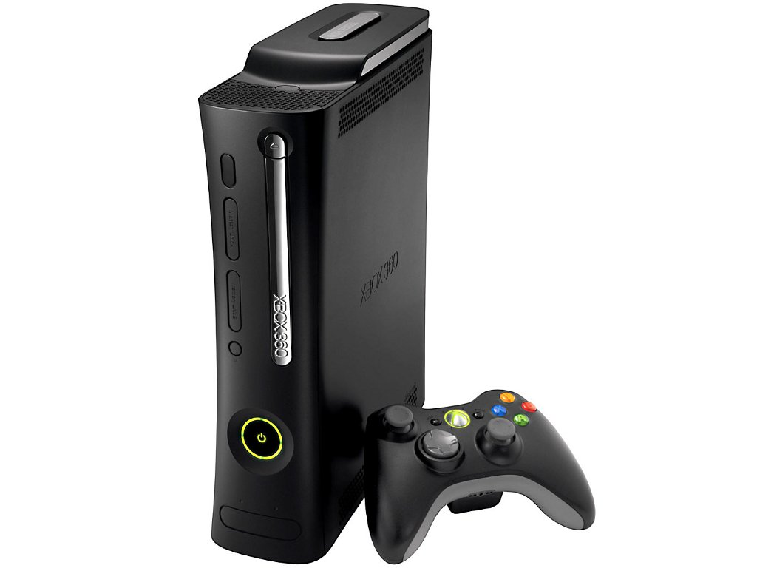
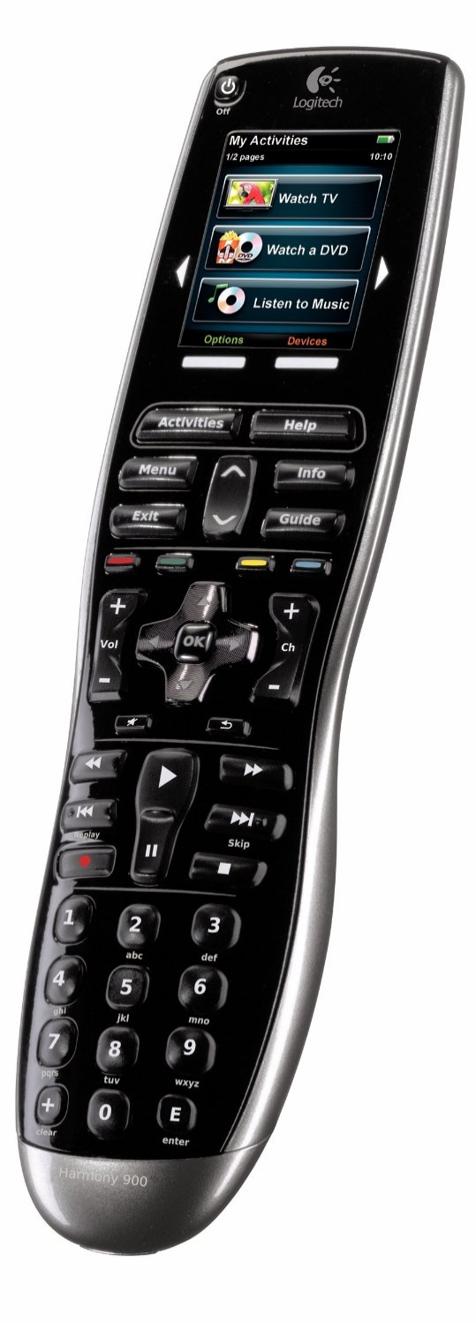
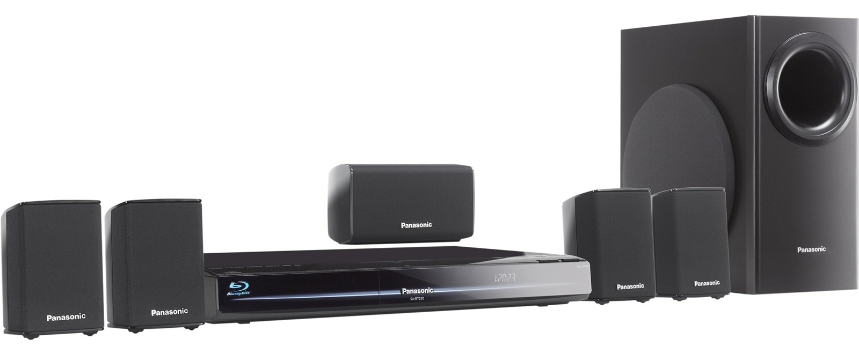
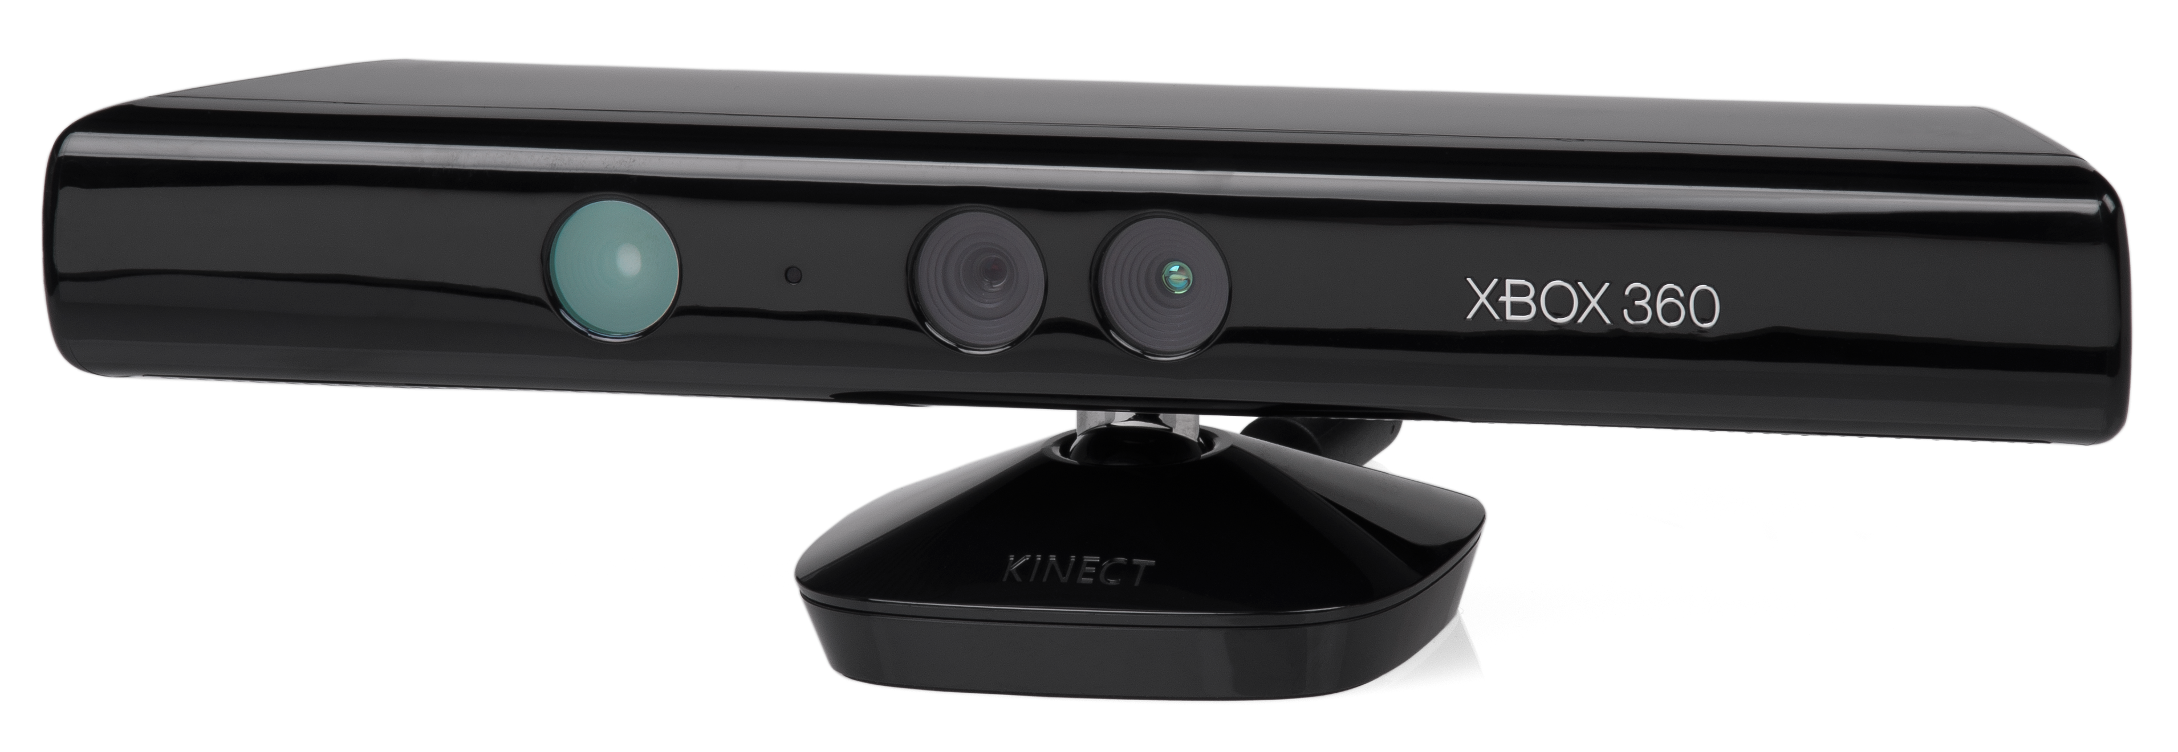
My Dream Home Theater (2010)

Slide 16
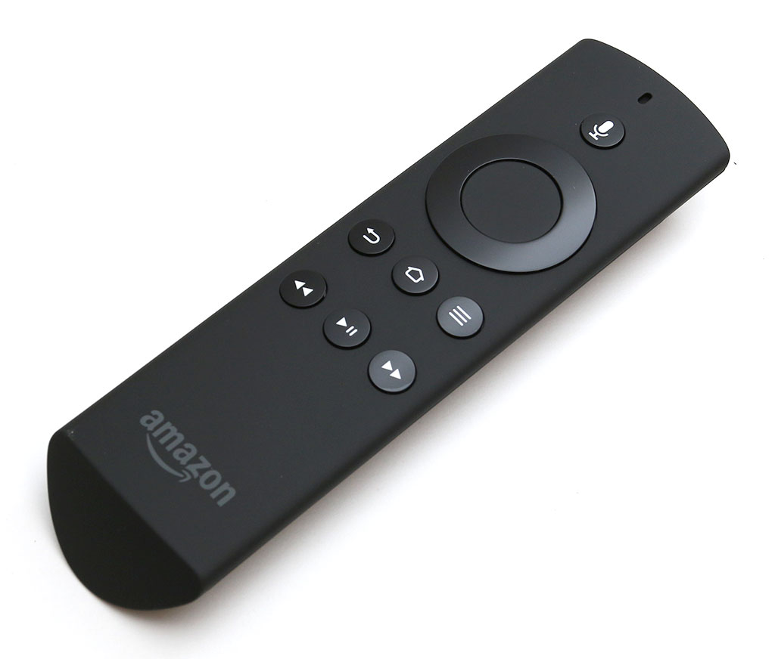
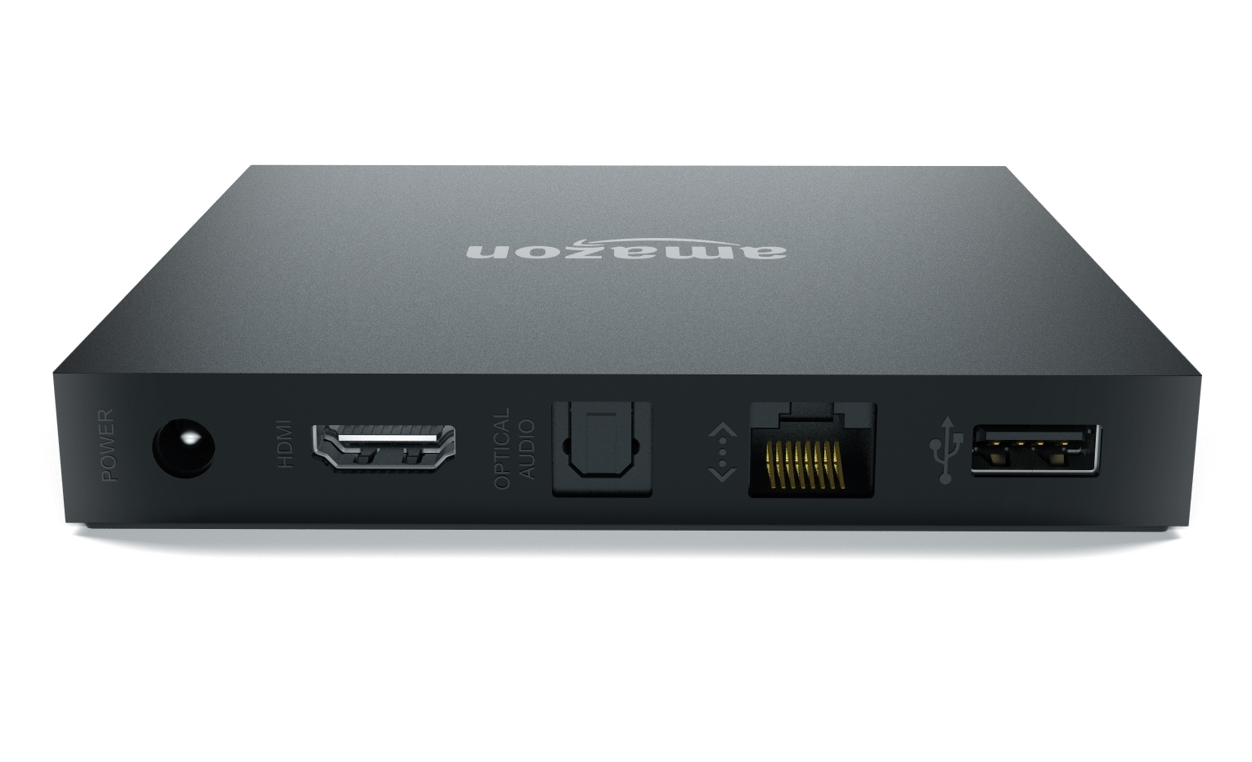
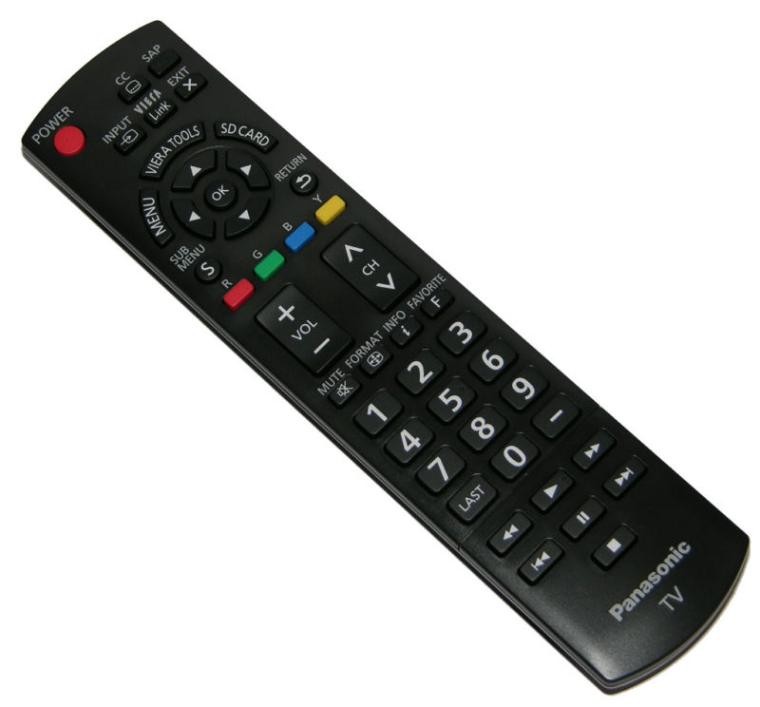
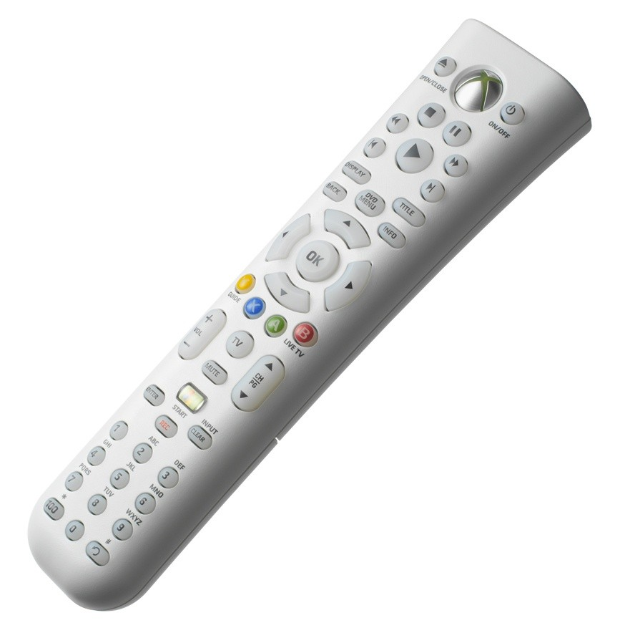
My Current Home Theater (2015)
Fire
HDMI
Bluetooth
Television
IR
Xbox (Universal)
HDMI
Vieralink
IR
HDMI
Wall/Repeater

Slide 17
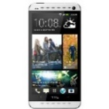
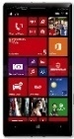
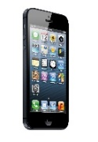

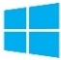

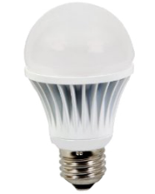
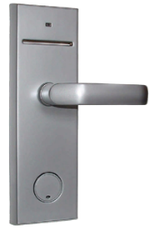
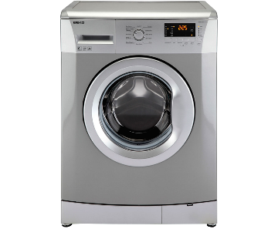
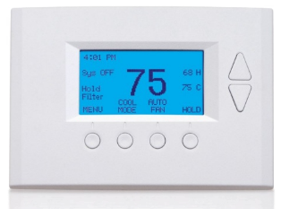
IoT Barrier: Proprietary Solutions
IHV Protocol
Std. Protocol
IHV/ISV API
Closed System

Slide 18
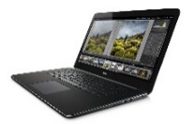
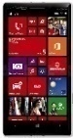
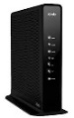

Example AllJoyn-Enabled IoT System
IoT Cloud
Azure or other cloud providers store data, process events, send notifications
IoT Cloud Data
Internet/Cloud
Proximal Network
Internet-Connected Node
AllJoyn apps and devices communicate on proximal network
AllJoyn Node

Slide 19
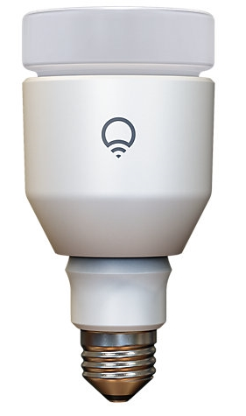
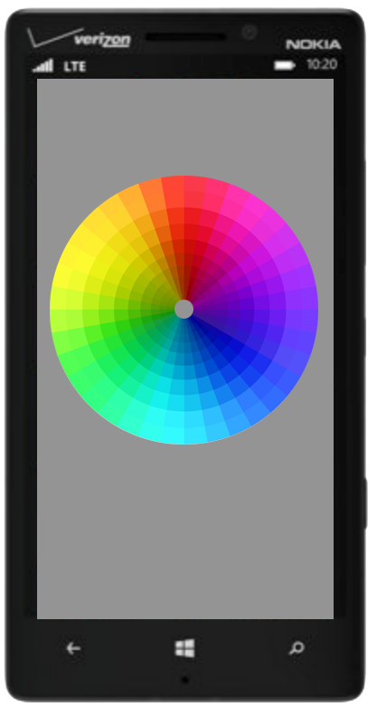
AllJoyn Software Roles
Consumer (client)
Discovers and connects to one or more producers. Controls thing and consumes data from thing.
Producer (server)
Represents a “thing” that implements one or more AllJoyn interfaces.
Lamp
Lighting App
Lamp
Lamp
Lighting Controller
AllJoyn apps/devices can be producers, consumers, or both

Slide 20
AllJoyn Base Services
Notification
Send and receive device notifications
Onboarding
Get devices onto wireless networks
Configuration
Manage and configure devices
Control Panel
Expose and consume simple device UX

Slide 21
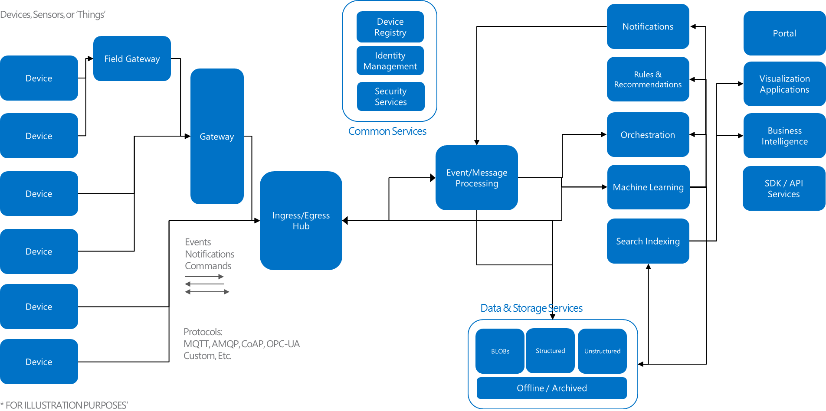
Internet of Things – Logical Architecture*

Slide 22
Démo

Slide 23
Architecture
Windows Phone
Azure Mobile
Services
Microsoft
Band
Netduino

Slide 24
Questions & réponses

Slide 25
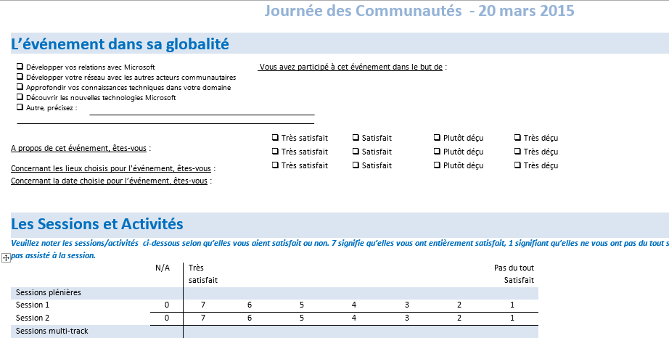
Evaluation JDC 2015
Merci de compléter votre formulaire d’évaluation!
1 formulaire sur 1 page à compléter tout au long de l’événement.
A remettre avant votre départ à l’une des personnes suivantes
Martine Thiphaine.
Sherley Frydman.
Othman Chiheb.
Cécile Boisson.
Notes:
AD

Slide 26

Merci!
Thomas LEBRUN MVP / Consultant Infinite Square
@thomas_lebrun
Alex DANVY Technical Evangelist Microsoft France
@danvy
© 2014 Microsoft Corporation. All rights reserved. Microsoft, Windows, Windows Vista and other product names are or may be registered trademarks and/or trademarks in the U.S. and/or other countries. The information herein is for informational purposes only and represents the current view of Microsoft Corporation as of the date of this presentation. Because Microsoft must respond to changing market conditions, it should not be interpreted to be a commitment on the part of Microsoft, and Microsoft cannot guarantee the accuracy of any information provided after the date of this presentation. MICROSOFT MAKES NO WARRANTIES, EXPRESS, IMPLIED OR STATUTORY, AS TO THE INFORMATION IN THIS PRESENTATION.

